Slide 1
Process Management

Slide 2
INDEX
Introduction
Parent/Child communication using fork()
Command execution using system() and exec()
Exec family function
Controlling Process Input and Output
Inter-process Communication
Signal Handling
Sending and Receiving Signals

Slide 3
INTRODUCTION
Implement concurrency by having each task (or process) operate in a separate memory space
Time slicing on single-processor systems divides processor time among many processes
Operating system allocates a short execution time called a quantum to a process
Operating system performs context switching to move processes and their dependent data in and out of memory

Slide 4
INTRODUCTION
Operating systems provides shells – programs that execute system commands on user’s behalf
Some operating systems have built-in system commands that enable programmers to create and manage processes (e.g. Portable Operating System Interface for UNIX (POSIX) standard defines these system commands for UNIX operating systems)

Slide 5
FORK FUNCTION
Function os.fork, available only on POSIX-compliant systems, creates a new process
Parent process invokes os.fork
Parent process forks (creates) a child process
Each process has a unique identifying process id number (pid)
Function os.fork’s return value
  0 for child process
  Child’s pid for parent

Slide 6
FORK FUNCTION
1
Parent (original) process executes
2
Parent process calls os.fork and assigns return value to forkPID
Parent process (forkPID is Child’s pid)
Parent process
3
Parent and child processes execute same program simultaneously
forkPID = os.fork()
Child process (forkPID is 0)

Slide 7
FORK FUNCTION
1 # Fig: fork.py
2 # Using fork to create child processes.
3
4 import os
5 import sys
6 import time
7
8 processName = "parent" # only the parent is running now
9
10 print "Program executing\n\tpid: %d, processName: %s" \
11 % ( os.getpid(), processName )
12
13 # attempt to fork child process
14 try:
15 forkPID = os.fork() # create child process
16 except OSError:
17 sys.exit( "Unable to create new process." )
18
19 if forkPID != 0: # am I parent process?
20 print "Parent executing\n" + \
21 "\tpid: %d, forkPID: %d, processName: %s" \
22 % ( os.getpid(), forkPID, processName )
23
Function os.fork raises OSError exception
if new process cannot be created

Slide 8
FORK FUNCTION
24 elif forkPID == 0: # am I child process?
25 processName = "child"
26 print "Child executing\n" + \
27 "\tpid: %d, forkPID: %d, processName: %s" \
28 % ( os.getpid(), forkPID, processName )
29
30 print "Process finishing\n\tpid: %d, processName: %s" \
31 % ( os.getpid(), processName )

Slide 9
FORK FUNCTION
Program executing
pid: 5428, processName: parent
Parent executing
pid: 5428, forkPID: 5429, processName: parent
Process finishing
pid: 5428, processName: parent
Child executing
pid: 5429, forkPID: 0, processName: child
Process finishing
pid: 5429, processName: child
Program executing
pid: 5430, processName: parent
Child executing
pid: 5431, forkPID: 0, processName: child
Process finishing
pid: 5431, processName: child
Parent executing
pid: 5430, forkPID: 5431, processName: parent
Process finishing
pid: 5430, processName: parent

Slide 10
COMMAND EXECUTION USING SYSTEM AND EXEC
Function os.system executes a system command using a shell and then returns control to the original process (after the command completes)
os.exec family of functions do not return control to calling process after executing the specified command
1 # Fig. 18.5: fig18_05.py
2 # Uses the system function to clear the screen.
3
4 import os
5 import sys
6
7 def printInstructions( clearCommand ):
8 os.system( clearCommand ) # clear display
9
10 print """Type the text that you wish to save in this file.
11 Type clear on a blank line to delete the contents of the file.
12 Type quit on a blank line when you are finished.\n"""
13
14 # determine operating system
15 if os.name == "nt" or os.name == "dos": # Windows system
16 clearCommand = "cls"
17 print "You are using a Windows system."

Slide 11
SYSTEM FUNCTION
18 elif os.name == "posix": # UNIX-compatible system
19 clearCommand = "clear"
20 print "You are using a UNIX-compatible system."
21 else:
22 sys.exit( "Unsupported OS" )
23
24 filename = raw_input( "What file would you like to create? " )
25
26 # open file
27 try:
28 file = open( filename, "w+" )
29 except IOError, message:
30 sys.exit( "Error creating file: %s" % message )
31
32 printInstructions( clearCommand )
33 currentLine = ""
34

Slide 12
SYSTEM FUNCTION
35 # write input to file
36 while currentLine != "quit\n":
37 file.write( currentLine )
38 currentLine = sys.stdin.readline()
39
40 if currentLine == "clear\n":
41
42 # seek to beginning and truncate file
43 file.seek( 0, 0 )
44 file.truncate()
45
46 currentLine = ""
47 printInstructions( clearCommand )
48
49 file.close()

Slide 13
SYSTEM FUNCTION
You are using a Windows system.
What file would you like to create? welcome.txt
You are using a UNIX-compatible system.
What file would you like to create? welcome.txt
Type the text that you wish to save in this file.
Type clear on a blank line to delete the contents of the file.
Type quit on a blank line when you are finished.
This will not be written to the file.
The following line will call clear.
clear

Slide 14
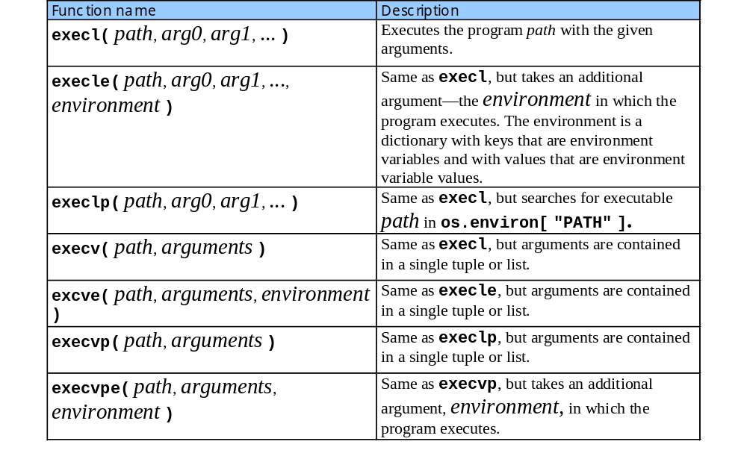
EXEC FAMILY FUNCTION

Slide 15
POPEN FUNCTION
UNIX-system users can use multiple programs together to achieve a particular result (e.g., ls | sort produces a sorted list of a directory’s contents)
1 # Fig. 18.9: fig18_09.py
2 # Demonstrating popen and popen2.
3
4 import os
5
6 # determine operating system, then set directory-listing and
7 # reverse-sort commands
8 if os.name == "nt" or os.name == "dos": # Windows system
9 fileList = "dir /B"
10 sortReverse = "sort /R"
11 elif os.name == "posix": # UNIX-compatible system
12 fileList = "ls -1"
13 sortReverse = "sort -r"
14 else:
15 sys.exit( "OS not supported by this program." )

Slide 16
POPEN FUNCTION
17 # obtain stdout of directory-listing command
18 dirOut = os.popen( fileList, "r" )
19
20 # obtain stdin, stdout of reverse-sort command
21 sortIn, sortOut = os.popen2( sortReverse )
22
23 filenames = dirOut.read() # output from directory-listing command
24
25 # display output from directory-listing command
26 print "Before sending to sort"
27 print "(Output from ’%s’):" % fileList
28 print filenames
29
30 sortIn.write( filenames ) # send to stdin of sort command
31
32 dirOut.close() # close stdout of directory-listing command
33 sortIn.close() # close stdin of sort command -- sends EOF
34
35 # display output from sort command
36 print "After sending to sort"
37 print "(Output from ’%s’):" % sortReverse
38 print sortOut.read() # output from sort command
39
40 sortOut.close() # close stdout of sort command

Slide 17
POPEN FUNCTION
Before sending to sort
(Output from 'ls -1'):
fig18_02.py
fig18_03.py
fig18_04.py
fig18_05.py
fig18_07.py
fig18_09.py
fig18_10.py
fig18_14.py
fig18_15.py
After sending to sort
(Output from 'sort -r'):
fig18_15.py
fig18_14.py
fig18_10.py
fig18_09.py
fig18_07.py
fig18_05.py
fig18_04.py
fig18_03.py
fig18_02.py

Slide 18
INTERPROCESS COMMUNICATION
Module os provides interface to many interprocess communication (IPC) mechanisms
Pipe, IPC mechanism, is a file-like object that provides a one-way communication channel
Function os.pipe creates a pipe and returns a tuple containing two file descriptors which provide read and write access to the pipe
Functions os.read and os.write read and write the files associated with the file descriptors

Slide 19
INTERPROCESS COMMUNICATION
1 # Figure: pipe.py
2 # Using os.pipe to communicate with a child process.
3
4 import os
5 import sys
6
7 # open parent and child read/write pipes
8 fromParent, toChild = os.pipe()
9 fromChild, toParent = os.pipe()
10
11 # parent about to fork child process
12 try:
13 pid = os.fork() # create child process
14 except OSError:
15 sys.exit( "Unable to create child process." )
16
17 if pid != 0: # am I parent process?
18
19 # close unnecessary pipe ends
20 os.close( toParent )
21 os.close( fromParent )
22

Slide 20
INTERPROCESS COMMUNICATION
23 # write values from 1-10 to parent’s write pipe and
24 # read 10 values from child’s read pipe
25 for i in range( 1, 11 ):
26 os.write( toChild, str( i ) )
27 print "Parent: %d," % i,
28 print "Child: %s" % \
29 os.read( fromChild, 64 )
30
31 # close pipes
32 os.close( toChild )
33 os.close( fromChild )
34
35 elif pid == 0: # am I child process?
36
37 # close unnecessary pipe ends
38 os.close( toChild )
39 os.close( fromChild )
40
41 # read value from parent pipe
42 currentNumber = os.read( fromParent, 64 )
43
44 # if we receive number from parent,
45 # write number to child write pipe
46 while currentNumber:
47 newNumber = int( currentNumber ) * 20
48 os.write( toParent, str( newNumber ) )
49 currentNumber = os.read( fromParent, 64 )
50

Slide 21
INTERPROCESS COMMUNICATION
51 # close pipes
52 os.close( toParent )
53 os.close( fromParent )
54 os._exit( 0 ) # terminate child process
Parent: 1, Child: 20
Parent: 2, Child: 40
Parent: 3, Child: 60
Parent: 4, Child: 80
Parent: 5, Child: 100
Parent: 6, Child: 120
Parent: 7, Child: 140
Parent: 8, Child: 160
Parent: 9, Child: 180
Parent: 10, Child: 200

Slide 22
INTERPROCESS COMMUNICATION
Read end
Write end
Parent pipe
Original process can write to either parent or child pipe
Original process can read from either parent or child pipe
Original process
Child pipe
Read end
Write end

Slide 23
INTERPROCESS COMMUNICATION
Patent process can read from parent and child pipe
Patent process can write to parent and child pipe
Parent process
Read end
Write end
Parent pipe
Child process can read from parent and child pipe
Child process can write to parent and child pipe
Child process
Child pipe
Read end
Write end

Slide 24
INTERPROCESS COMMUNICATION
Parent process
Read end
Write end
Parent process reads from child pipe and writes to parent pipe
Parent pipe
Child process reads from parent pipe and writes to child pipe
Child process
Child pipe
Read end
Write end

Slide 25
SIGNAL HANDLING
Processes can communicate with signals, which are messages that operating systems deliver to programs asynchronously
Signal processing: program receives a signal and performs an action based on that signal
Signal handlers execute in response to signals
Every Python program has default signal handlers
How to send signals:
Executing programs can send signals to other processes
Function os.kill sends a signal to a particular process identified by its pid

Slide 26
SIGNAL HANDLING
1 # Fig: Signal_Handle.py
2 # Defining our own signal handler.
3
4 import time
5 import signal
6
7 def stop( signalNumber, frame ):
8 global keepRunning
9 keepRunning -= 1
10 print "Ctrl-C pressed; keepRunning is", keepRunning
11
12 keepRunning = 3
13
14 # set the handler for SIGINT to be function stop
15 signal.signal( signal.SIGINT, stop )
16
17 while keepRunning:
18 print "Executing..."
19 time.sleep( 1 )
20
21 print "Program terminating..."

Slide 27
SIGNAL HANDLING
Executing...
Executing...
Ctrl-C pressed; keepRunning is 2
Executing...
Executing...
Ctrl-C pressed; keepRunning is 1
Executing...
Executing...
Ctrl-C pressed; keepRunning is 0
Program terminating...

Slide 28
SIGNAL HANDLING
1 # Fig. 18.15: fig18_15.py
2 # Sending signals to child processes using kill
3
4 import os
5 import signal
6 import time
7 import sys
8
9 # handles both SIGALRM and SIGINT signals
10 def parentInterruptHandler( signum, frame ):
11 global pid
12 global parentKeepRunning
13
14 # send kill signal to child process and exit
15 os.kill( pid, signal.SIGKILL ) # send kill signal
16 print "Interrupt received. Child process killed."
17
18 # allow parent process to terminate normally
19 parentKeepRunning = 0
20
21 # set parent's handler for SIGINT
22 signal.signal( signal.SIGINT, parentInterruptHandler )
23
24 # keep parent running until child process is killed
25 parentKeepRunning = 1
26
Signal handler enables parent process
to handle interrupt signal
Sends kill signal signal.SIGKILL to process
with specified pid

Slide 29
SIGNAL HANDLING
27 # parent ready to fork child process
28 try:
29 pid = os.fork() # create child process
30 except OSError:
31 sys.exit( "Unable to create child process." )
32
33 if pid != 0: # am I parent process?
34
35 while parentKeepRunning:
36 print "Parent running. Press Ctrl-C to terminate child."
37 time.sleep( 1 )
38
39 elif pid == 0: # am I child process?
40
41 # ignore interrupt in child process
42 signal.signal( signal.SIGINT, signal.SIG_IGN )
43
44 while 1:
45 print "Child still executing."
46 time.sleep( 1 )
47
48 print "Parent terminated child process."
49 print "Parent terminating normally."

Slide 30
SIGNAL HANDLING
Parent running. Press Ctrl-C to terminate child.
Child still executing.
Parent running. Press Ctrl-C to terminate child.
Child still executing.
Child still executing.
Parent running. Press Ctrl-C to terminate child.
Interrupt received. Child process killed.
Parent terminated child process.
Parent terminating normally.

